Slide 1
Sales Dataset Analysis – Advanced Excel Project
JERIN P
12.12.2024
Data analytics & Data Science
Oct 2024(regular)

Slide 2
PROJECT OVERVIEW To analyze sales data to identify trends, understand sales performance, and provide actionable business insights.
OBJECTIVES
Analyze sales trends over time.
Identify high-performing products and sales channels.
Determine the impact of returns and discounts.
Create a dynamic dashboard with key metrics.

Slide 3
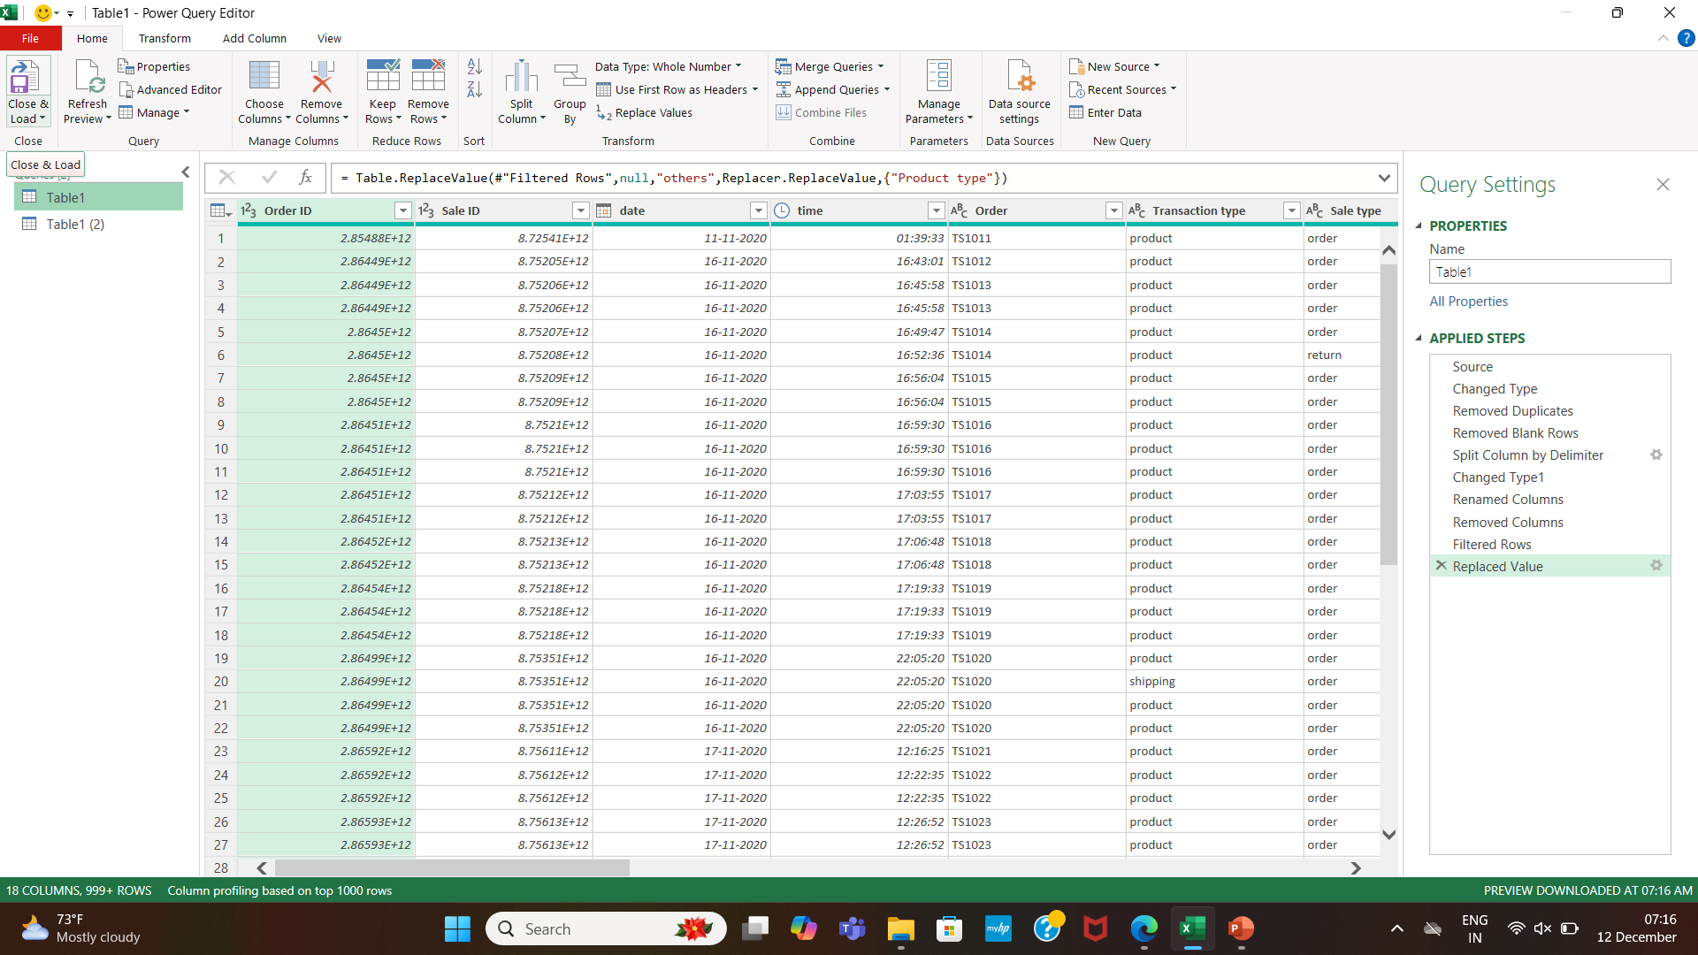
DATA SET OVERVIEW
DATA CLEANING
Removed Blank Rows, Duplicate Rows and Splited colums.
Cleaned Using Power Query

Slide 4
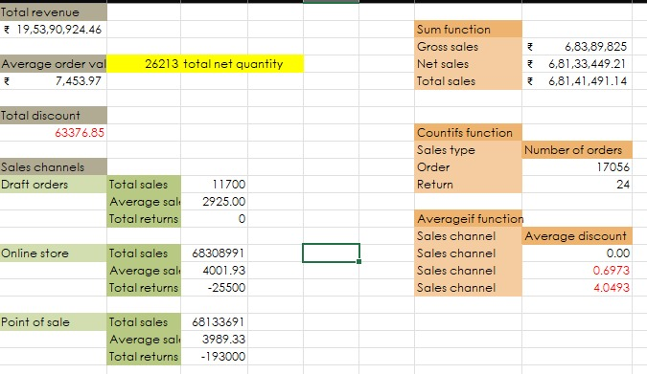
IMPORTANT CALCULATIONS
Total sales (Gross, Net, Adjusted)
Average sales per order
Discount rates, return rates
Sales by channel/product type

Slide 5
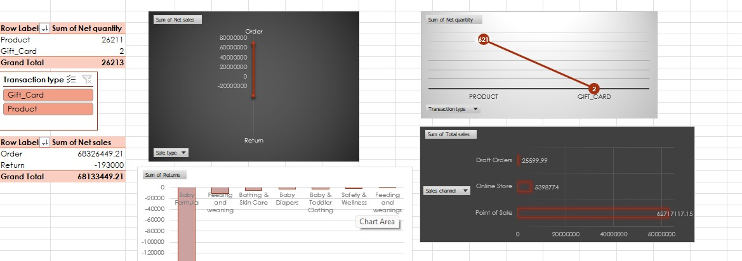
PIVOT TABLES AND CHARTS

Slide 6
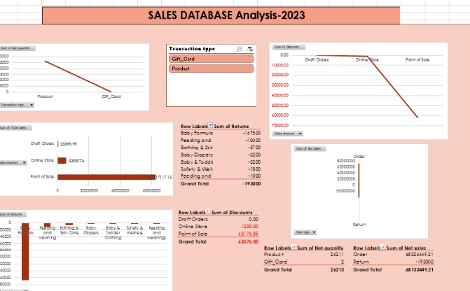
DASHBOARD

Slide 7
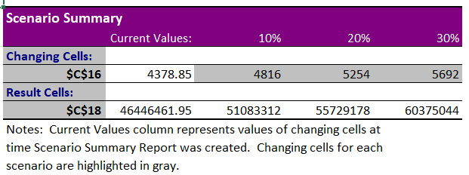
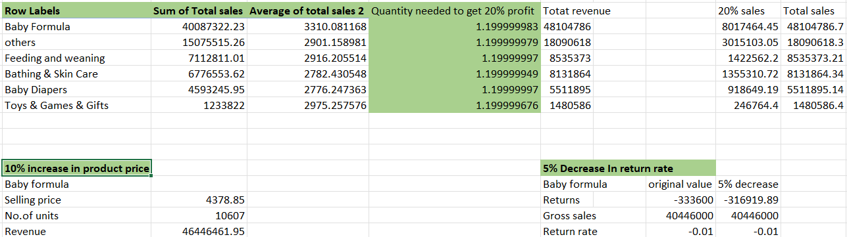
WHAT-IF ANALYSIS
GOAL SEEK

Slide 8
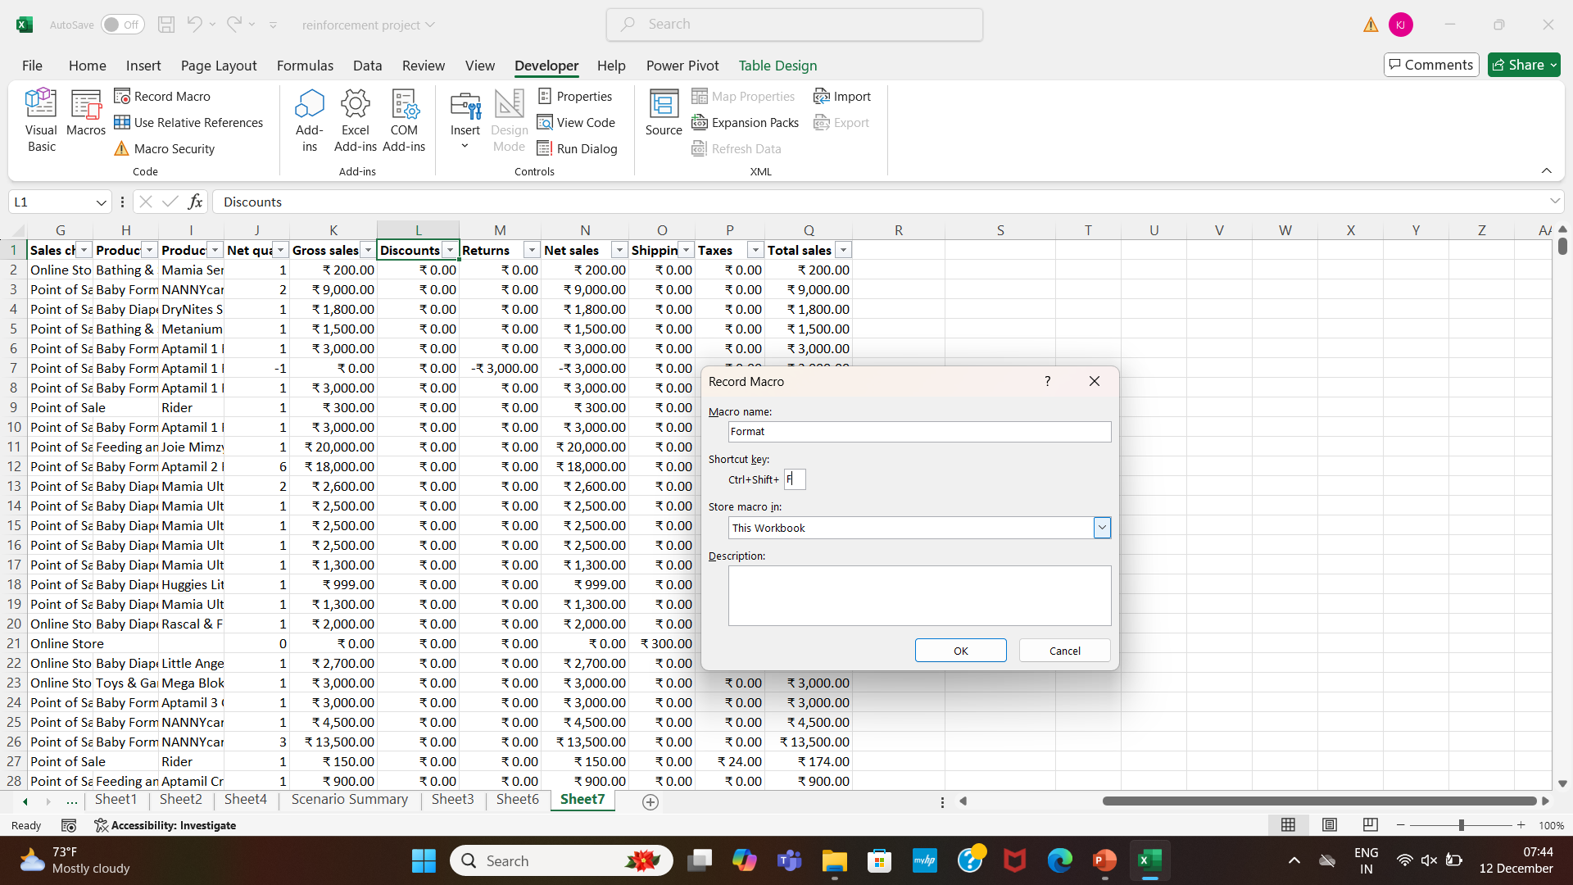
MACRO

Slide 9
Conclusion
The slides progressively build from introducing the project to demonstrating technical expertise in Excel functions, PivotTables,
and dashboard creation. It concludes with insights and business recommendations, ensuring a clear narrative that highlights the project's value.

Slide 10

BY JERIN

